Slide 1
AerTab Series Product Introduction AT-1450
July 2016

Slide 2
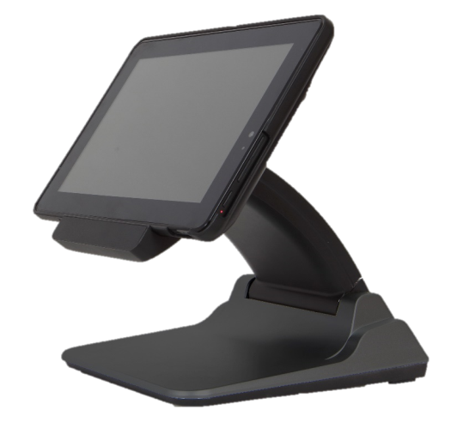
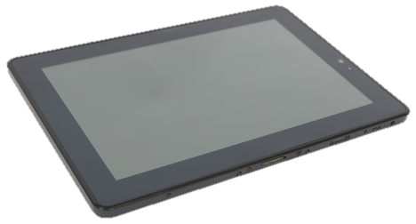
Modular Solution
10” Mobile POS
Intel
Cherry Trail
Quad Core
1.84G
Cradle + Station
Intel
Cherry Trail
Quad Core
1.84G

Slide 3
AT-1450 10” Mobile POS

Slide 4
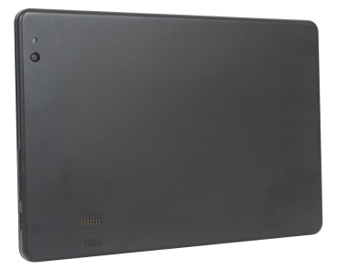
Specifications
Specifications
Screen | 10.1” IPS, 1280x800, 350nits, 25K
Touch | Projected Capacitive (Multi-touch)
Processor | Intel Cherry Trail Quad Core Atom X5 Z8300 1.44G ~ 1.84G
OS | Android 5.1 | Windows 10
Built-in Storage | eMMC 32G (for Android) | eMMC 64G (for Windows)
2nd Storage | Micro SD Card Slot (Max: 128 GB)
Memory | LP DDR3 2G | LP DDR3 4G
Camera | Front Camera: 2 MP (Default) , Rear Camera: 8 MP (Optional)
Connection | Wifi 802.11 b/g/n , Bluetooth 4.0
Battery | Non-Removable 6800mAh Li-on
Sensor | Accelerator-sensor / Gyroscope / Light sensor
Line out | 3.5 Phone Jack
Micro USB | OTG / DC in
Mic In | DMIC
Speakers | 1W x 2 Speakers
Size & Weight | 264.5mm x 182mm x 10.7mm ; 678g

Slide 5
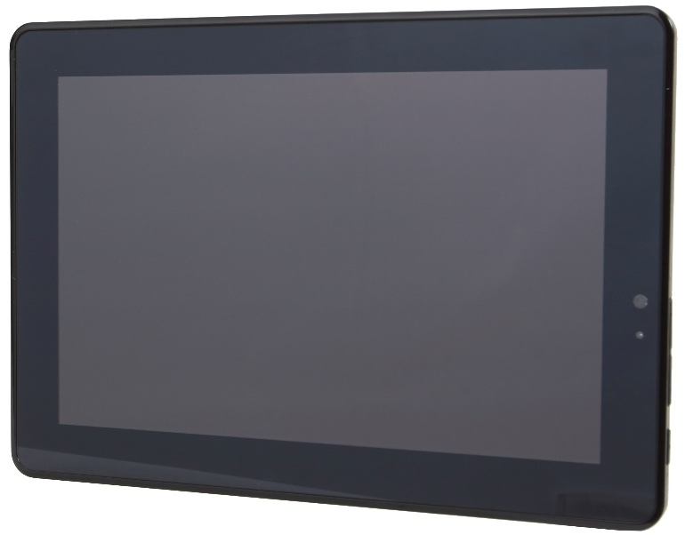
A Quick Tour for AT-1450
10.1” IPS
Touch Display
Front Camera 2MP
Light Sensor
Volume
Up Button
Power Button
Power LED
Down Button
Red
Charging
Blue
Discharging
Purple
Full

Slide 6
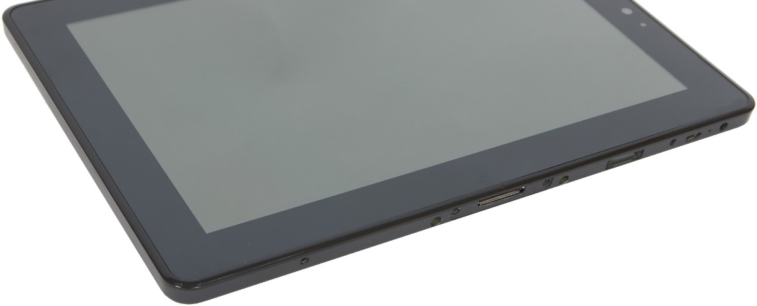
A Quick Tour for AT-1450
3.5 Phone Jack
Mic
Micro USB(OTG/DC In)
SD Card
Docking Port

Slide 7
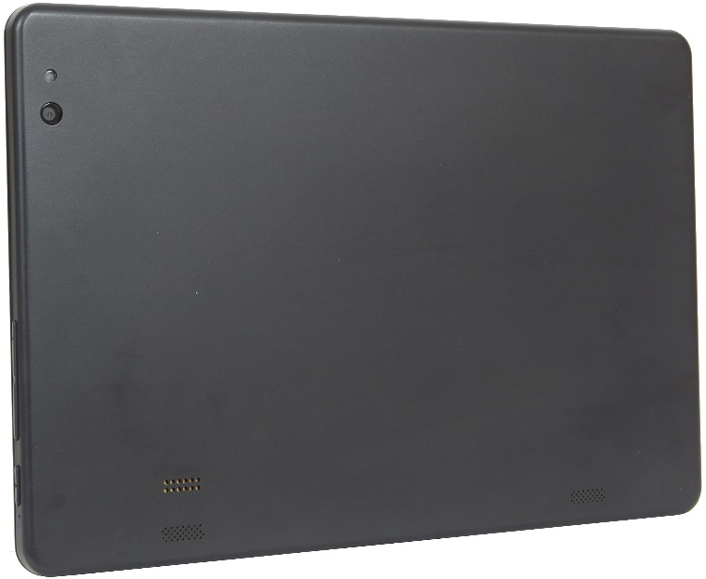
A Quick Tour for AT-1450
Read Camera 8MP
Cradle Port
Speaker

Slide 8
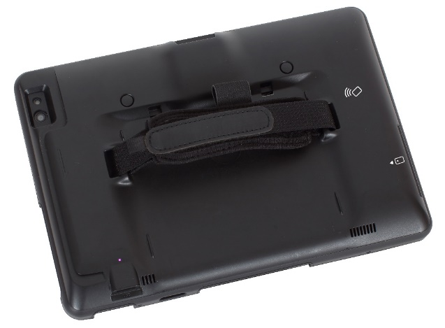
Service Cradle
Specifications
Protection | Free Fall 1.2M
Add-on Options
 | MSR (ISO T1/2/3)
 | 1D/2D Scanner
 | IC Card Reader
 | NFC Reader/Writer
 | Battery 6800mAh
 | 1 x USB 2.0 port
Size & Weight | 268mm x 187mm x 32.3mm 458g (depends on add-on devices)
Cradle with peripheral options (Max 3 items, chosen out of 4), 1 x USB 2.0 port (NFC and ID tech IC is at same location).

Slide 9
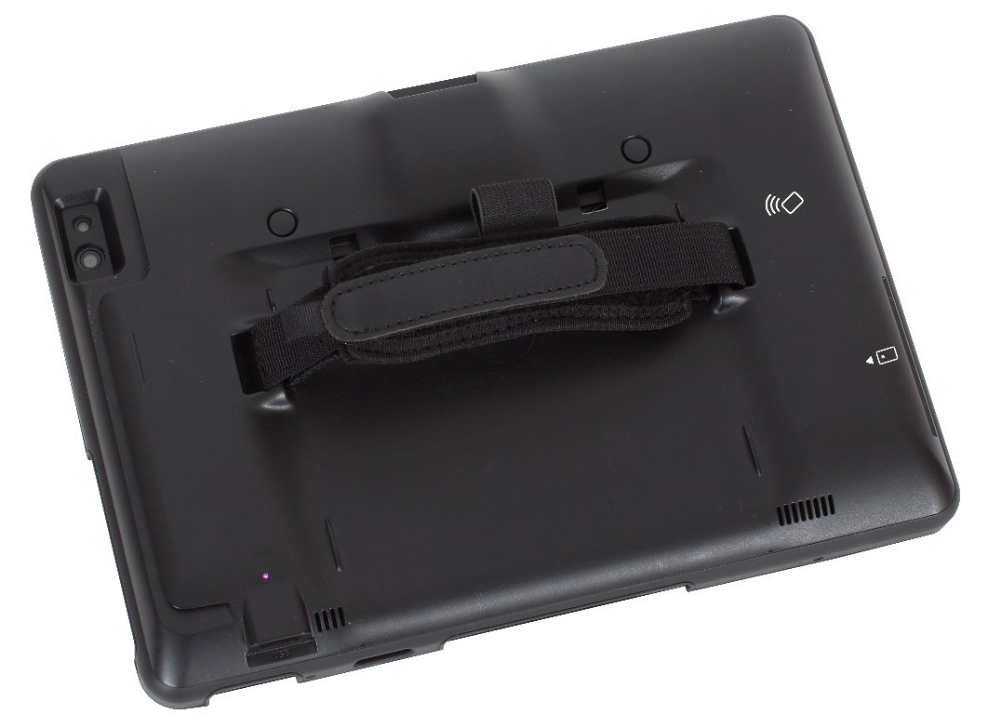
A Quick Tour for Cradle
2D Barcode Scanner
Scanner Button
NFC
IC Card Reader
MSR
Battery LED
USB 2.0
Red
Charging
Blue
Discharging
Purple
Full

Slide 10
A Quick Tour for Cradle
Cradle Port

Slide 11
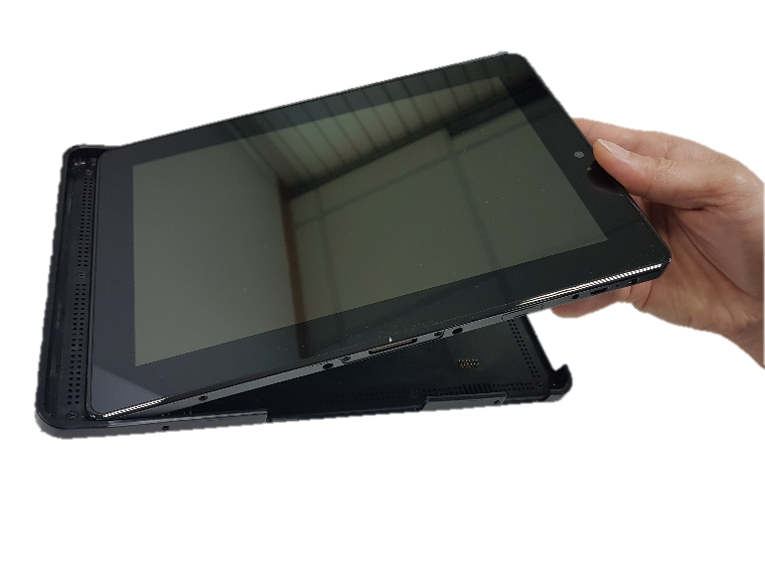
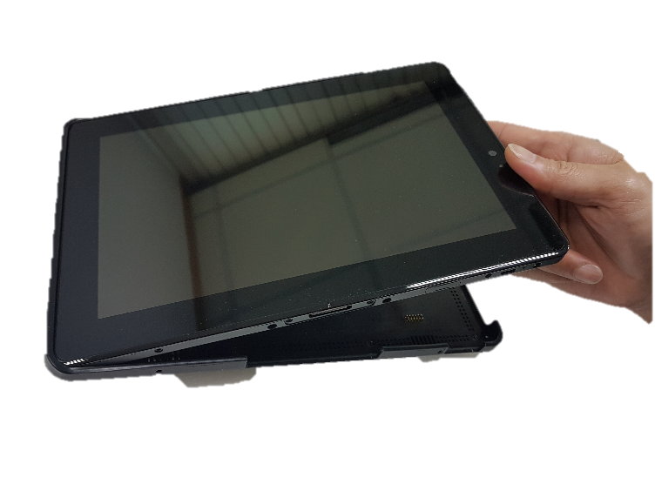
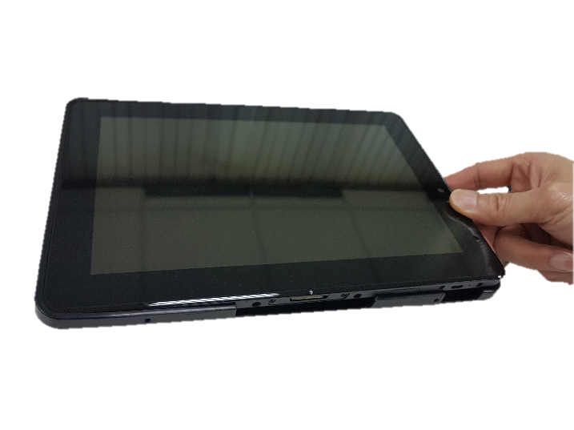
AT-1450+Cradle Assembly

Slide 12
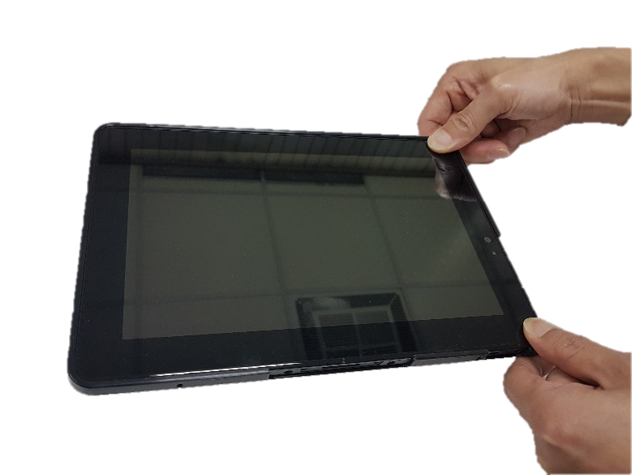
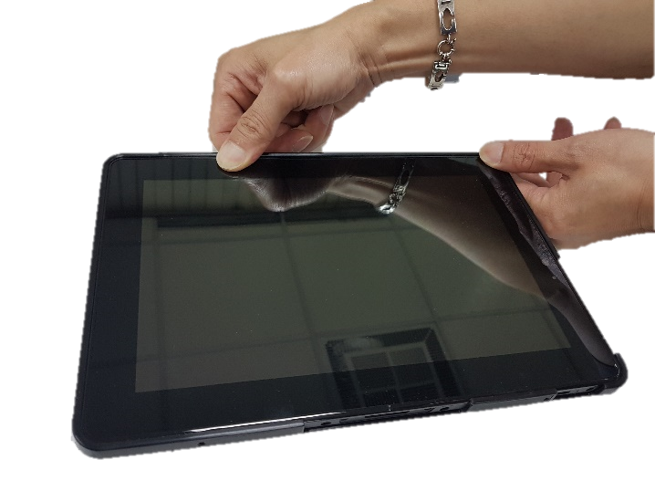
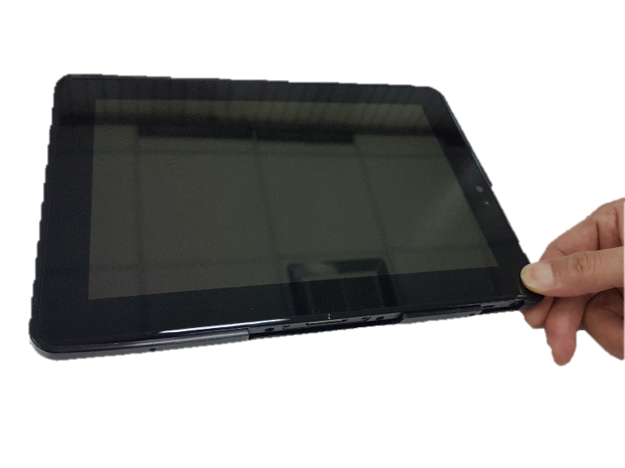
AT-1450+Cradle Assembly

Slide 13
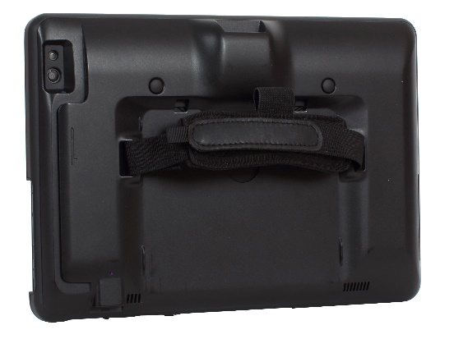
AT-1450+Cradle Assembly

Slide 14
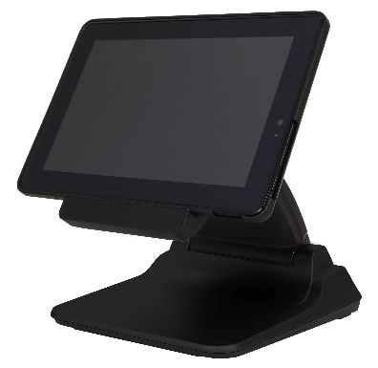
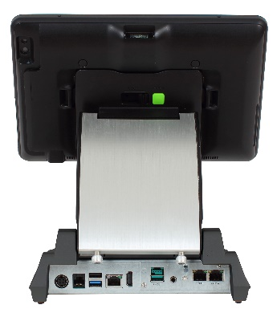
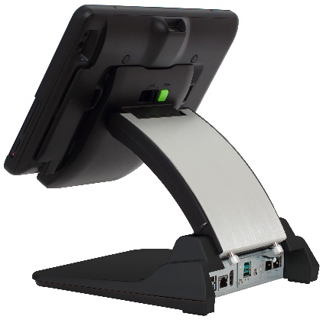
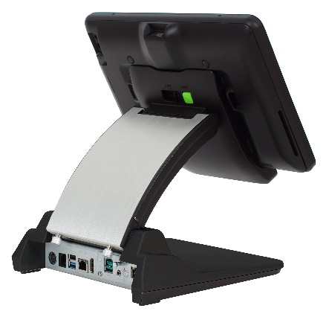
Docking Station
Service Station
Default I/O Port
 | 12V DC in
 | 12V RJ-11 Cash Drawer Port
 | Full HDMI port
 | 10/100 Ethernet
 | 2 x USB 2.0
Power Adaptor | 12V 60W / 12V 150W
Optional I/O | Type A/B/C/G/H

Slide 15
Docking Station Second I/O
Type A |  |  | 1*24V Out、 2*RJ45 COM port
Type B |  |  | 1*PUSB24V、2*RJ45COM Port
Type C |  |  | 1*PUSB12V、2*RJ45COM Port
Type G |  |  | 3*PUSB12V
Type H |  |  | 1*PUSB24V、2*PUSB12V

Slide 16
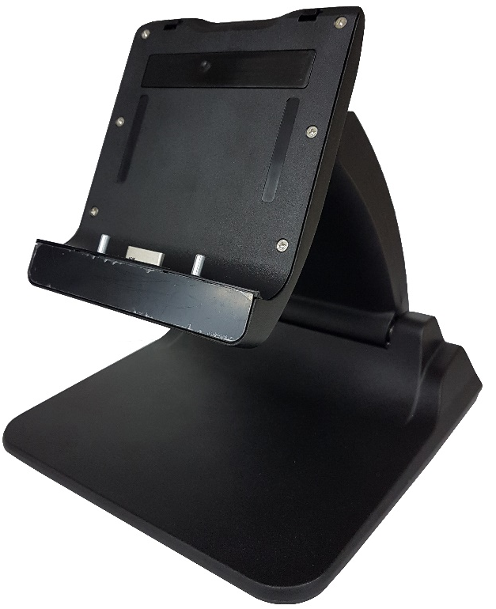
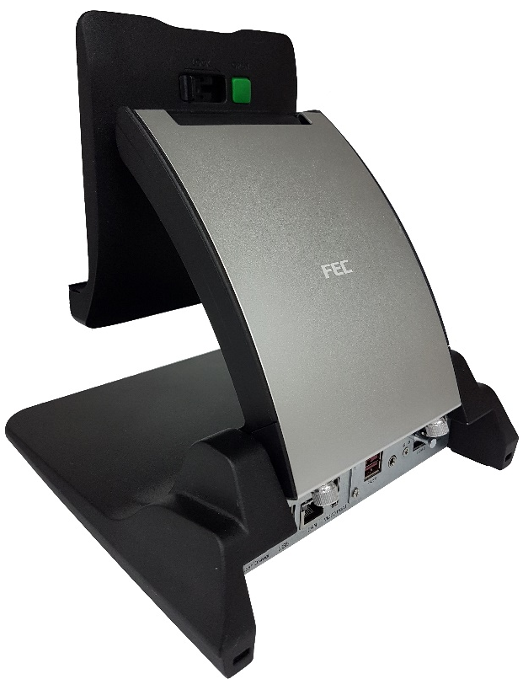
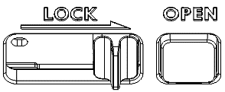
A Quick Tour for Docking Station
Tablet Lock
Docking Connector
IO Port
2nd IO

Slide 17
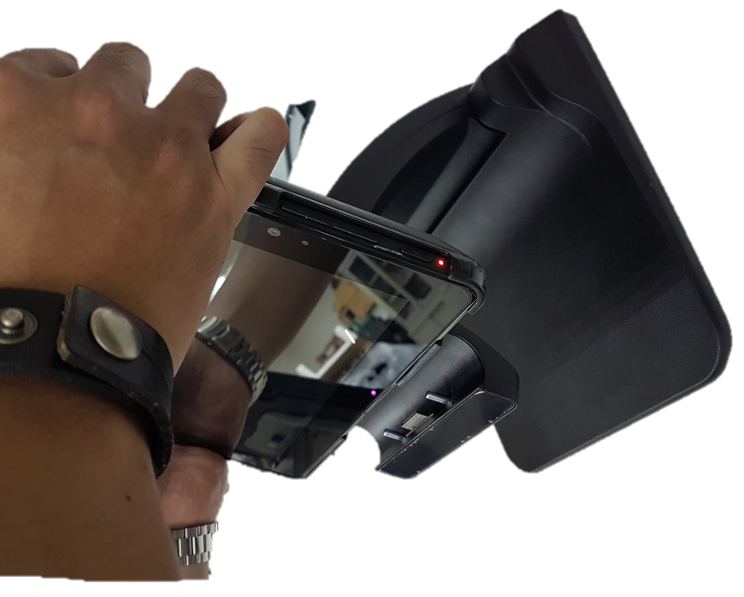
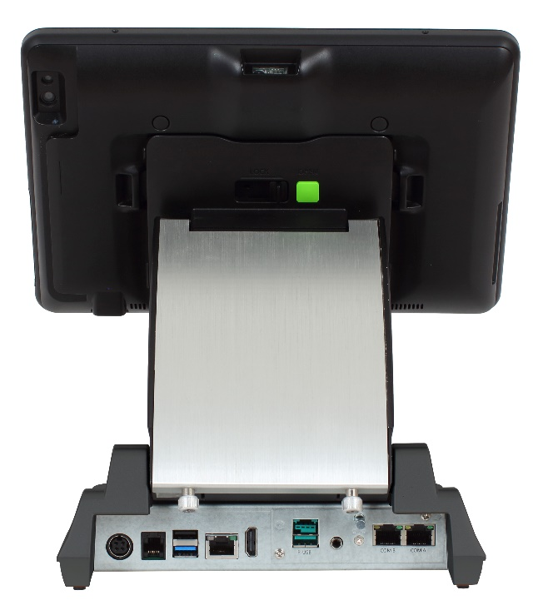
A Quick Tour for Docking Station

Slide 18
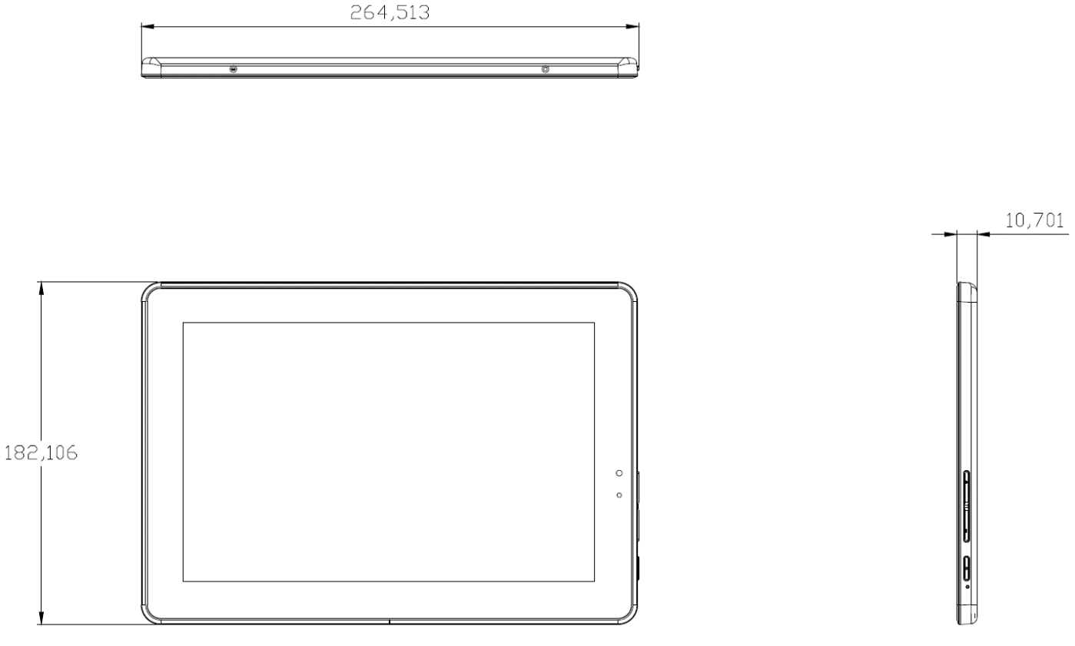
AT-1450 Dimension

Slide 19
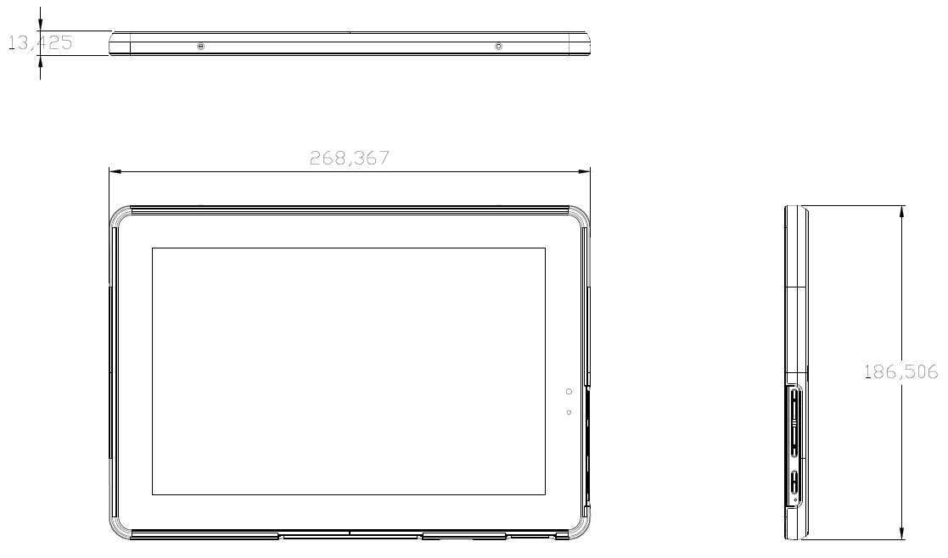
AT-1450 Dimension

Slide 20
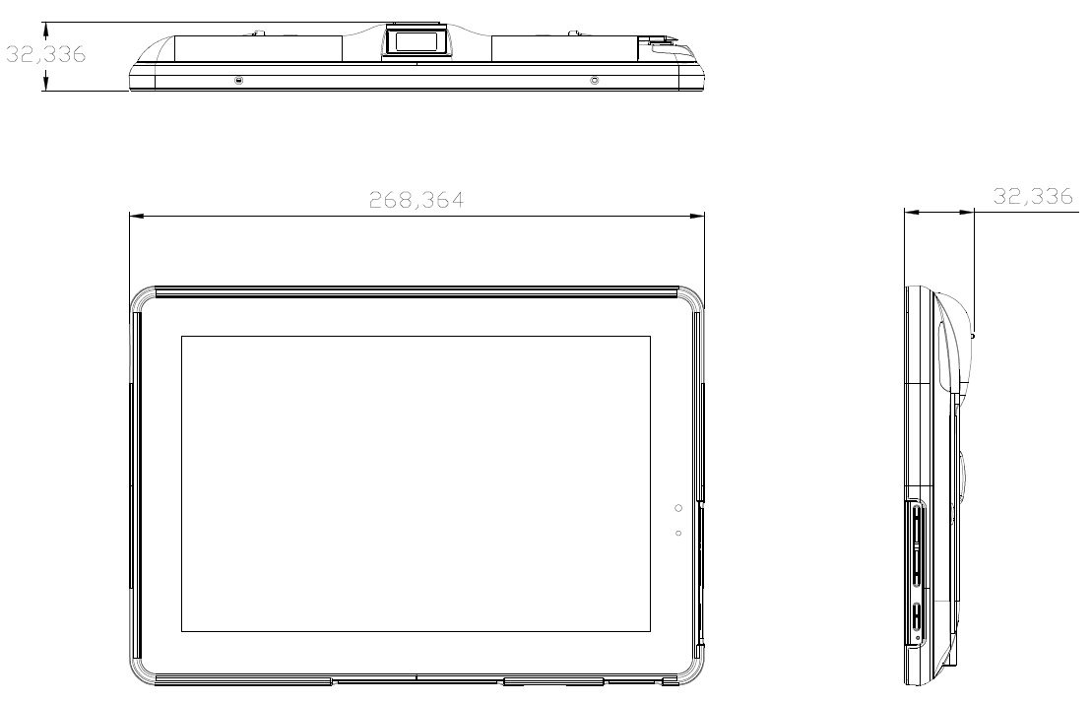
AT-1450+Cradle Dimension

Slide 21
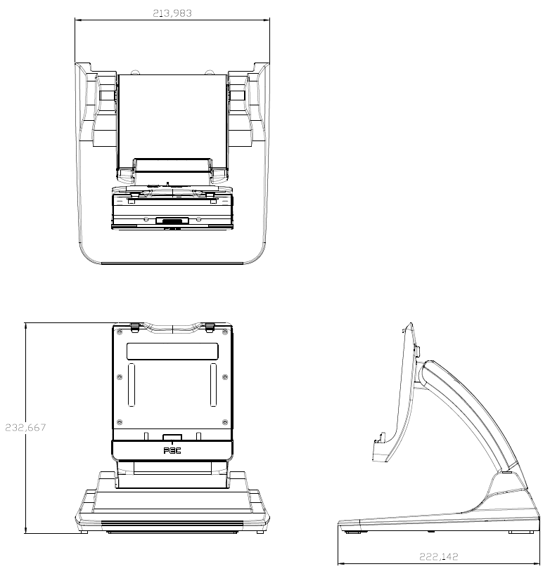
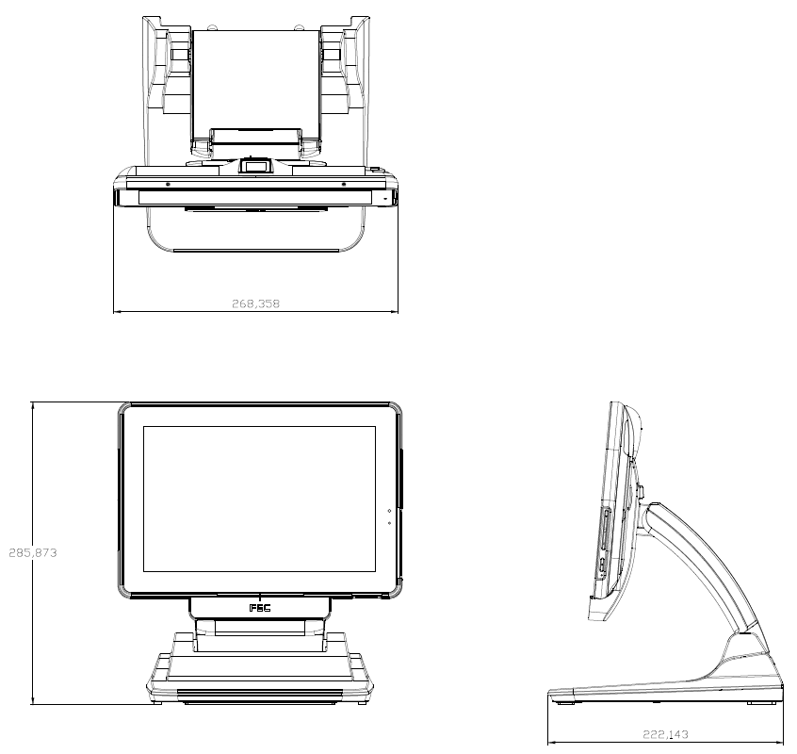
AT-1450+Station Dimension

Slide 22
Gallery

Slide 23
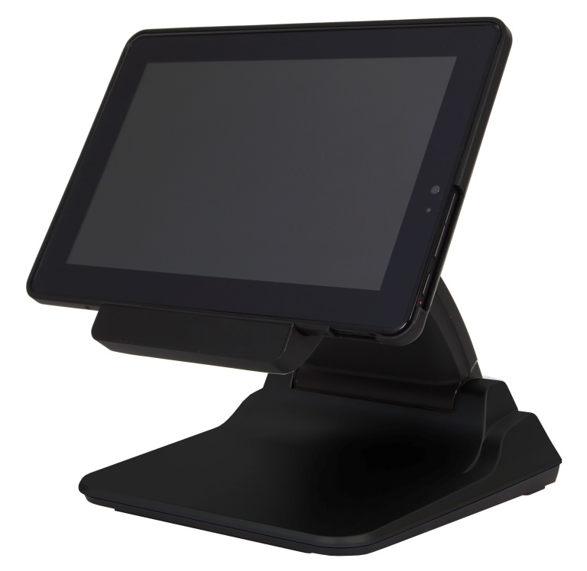
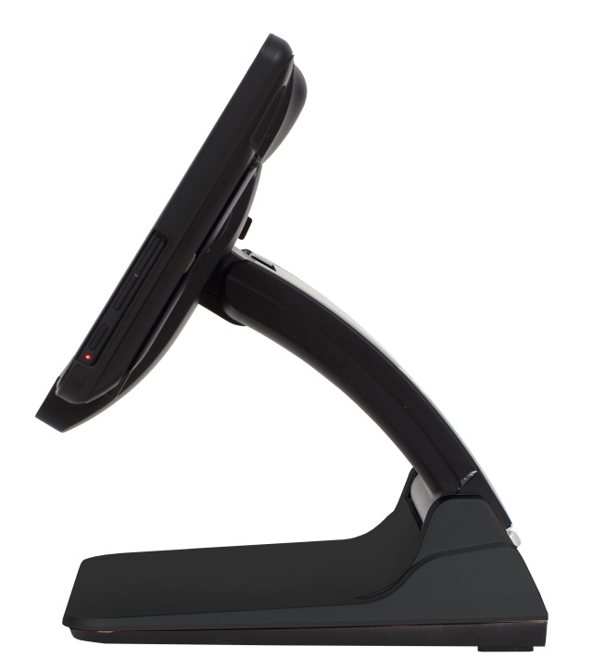
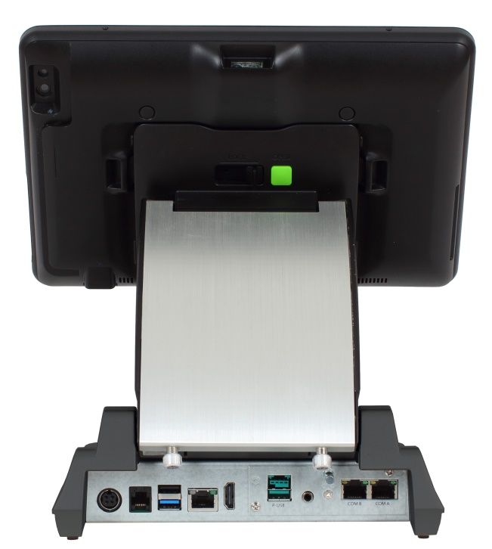
AT-1450 (w/ Docking Station) Black

Slide 24
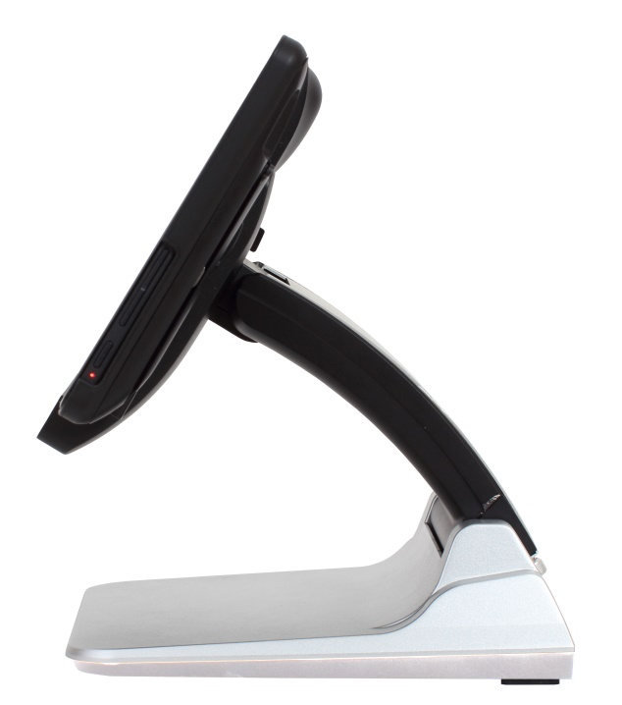
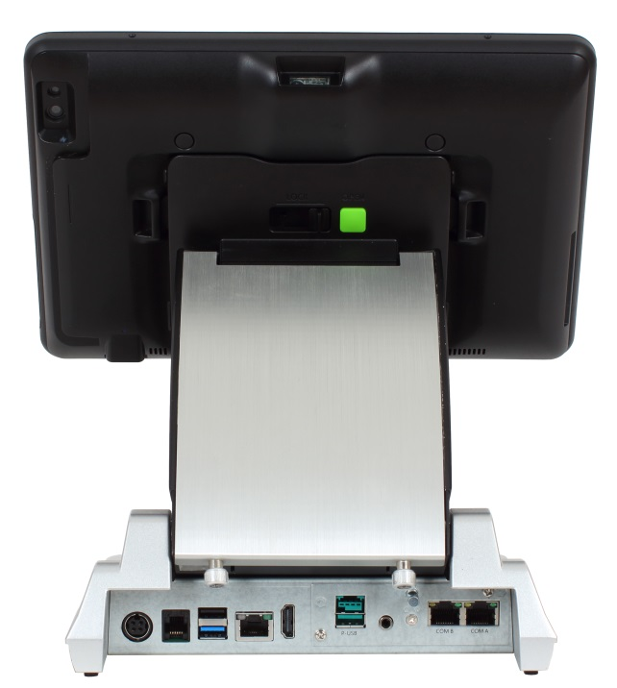
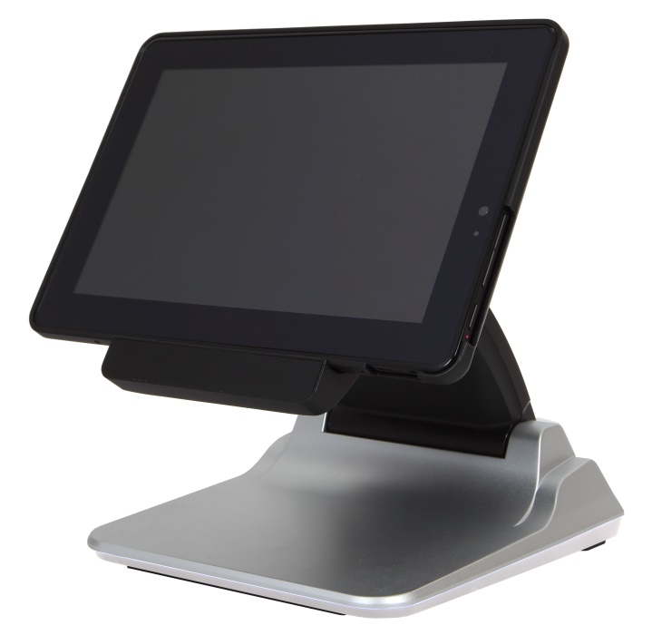
AT-1450 (w/ Docking Station) Silver

Slide 25
Thank You!

